Slide 1
Quick and Easy Forensic Timelines via Sysmon, WEF, and ELK
Presented by
Aaron Jewitt
@acjewitt

Slide 2
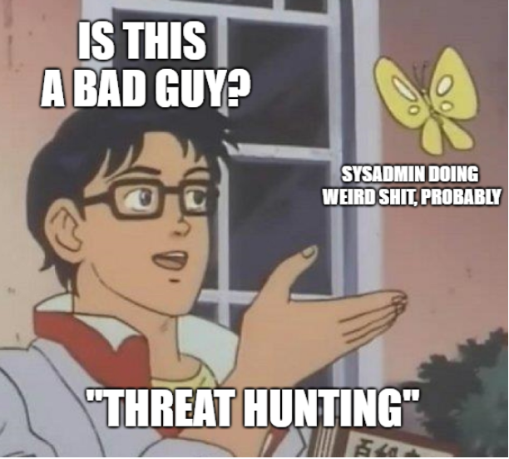
# whoami
"Threat" Hunter
Working for Booz Allen Hamilton
But soon I start a new job with Elastic
Former NSA ROC operator
Father of 3 boys
American living in Frankfurt
Collector of SANS certifications
All opinions in this talk are my own
Notes:
How presentation will benefit audience: Adult learners are more interested in a subject if they know how or why it is important to them.
Presenter’s level of expertise in the subject: Briefly state your credentials in this area, or explain why participants should listen to you.

Slide 3
# what this talk is about
Using Kibana or Splunk dashboards to make it faster and easier to Respond to alerts and investigate hosts, users, and processes in your network
What the talk is not about (but it could be if I had more time)
Anomaly detection and alerting using this data
Threat Hunting with this data
Step-by-step walkthrough of setting up the event data pipeline
Absolutely zero Blockchain or AI in this talk.

Slide 4
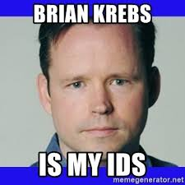
# scenario
Brian Krebs just called your CISO on a Saturday and gave her two computer and user names he saw in a compromise. She wants forensic timeline of events from those systems and all user activity ASAP. One is in Singapore, the other is in New York, and you are in Frankfurt.
How long does it take to collect and analyze the data?
How many people are capable of completing this task?

Slide 5
# problem
During an attack you have to be able to move as fast as the attacker
Getting data for forensics investigations can take a long time
Get the data, parse the data, analyze the data…
Evidence will be spread through multiple locations
Time zones are a pain
Permissions on the remote systems may stop you
You need to have DFIR specialists on the team to collect information
Or you need hire Incident Response consultants $$$ €€€ £££

Slide 6
# problem++
Traditional SIEMs only contain alerts
Alerts tell you that something happened, but not the whole story
Attackers will delete host logs to hide their tracks
Attackers will compromise user accounts to spread and persist
Evading antivirus is super easy to do – then there aren’t any alerts
When the AV does find something the alerts don't tell you much
Notes:
Lesson descriptions should be brief.

Slide 7
# Solution – What?
Create Kibana or Splunk dashboards to make forensic timelines easy
Timeline of all activity on a host
Timeline of all activity of a User
Timeline of all activity of a process
Elastic & Splunk are good for Forensic Science, not just Data Science
(Don’t let the Data Scientists take all the cool toys!)

Slide 8
# solution – How?
Enable verbose logging on hosts
- Deploy Sysmon to all windows hosts in your enterprise
- Deploy Elastic’s Auditbeat System Module to all *nix/MacOS systems
Centralized collection of Logs and Windows Events
Create dashboards and alerts in Kibana or Splunk
Notes:
Example objectives
At the end of this lesson, you will be able to:
Save files to the team Web server.
Move files to different locations on the team Web server.
Share files on the team Web server.

Slide 9

STEP 1: Getting the right logs

Slide 10
# Sysmon overview
If you have a windows domain you need Sysmon!
Sysmon is a free utility from Microsoft that turns on lots of great logging
Config file allows very granular control of what gets logged and what doesn’t
https://docs.microsoft.com/en-us/sysinternals/downloads/sysmon
https://www.rsaconference.com/writable/presentations/file_upload/hta-t09-how-to-go-from-responding-to-hunting-with-sysinternals-sysmon.pdf
Notes:
Example objectives
At the end of this lesson, you will be able to:
Save files to the team Web server.
Move files to different locations on the team Web server.
Share files on the team Web server.

Slide 11
# sysmon logging
Process start and stop
File Timestamp changes
File Creation
Network connections
Registry changes
File Downloads
Named Pipes
Driver Loading
WMI Subscriptions
Modules & dlls loaded in memory
Process Memory Access

Slide 12
# sysmon config tips
Start with Taylor Swift’s config and work from there
https://github.com/SwiftOnSecurity/sysmon-config
Start with a small test group while building your config!!!
Every Domain is unique, take the time to tune the config
Constant testing and changing – it never ends
New software deployments will break your config

Slide 13
# sysmon config tips
Exclude known good, include everything else
You must whitelist events or you will flood the system
Whitelist with caution – be as specific as possible
If you whitelist an event you will have no evidence of it
If you whitelist a folder
Whitelist the full commandline of a process, not the process name

Slide 14
# sysmon management tips
Keep multiple read only configs on the NETLOGON share
At a minimum you should have 3 production and 3 test group configs
Workstations
Domain controllers
Servers
Use Group Policy and PowerShell to deploy and regularly update
Test before deploying to production!
And don’t make changes on a Friday…

Slide 15
# Elastic auditbeat system module
It’s like sysmon for Linux and Mac (also works on Windows)
Experimental module released by Elastic on Jan 29th
host information – Unique host ID, uptime, changes to IP or hostname, etc.
process info – command line, hash, path, user
socket creation – src, dst, calling process, user
user logons – UID, GUID, Shell, CWD
Because linux logging is a mess.
https://www.elastic.co/blog/introducing-auditbeat-system-module

Slide 16
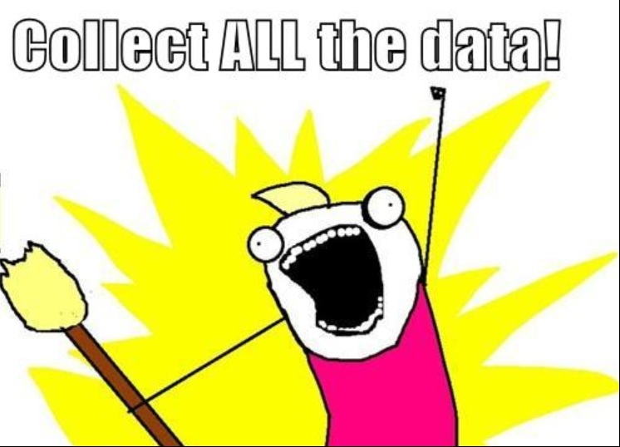
# Additional data for forensics
Enable auditing of changes to active directory objects on your DC
Autoruns – collect daily
https://github.com/palantir/windows-event-forwarding/tree/master/AutorunsToWinEventLog
Other Windows Event logs

Slide 17
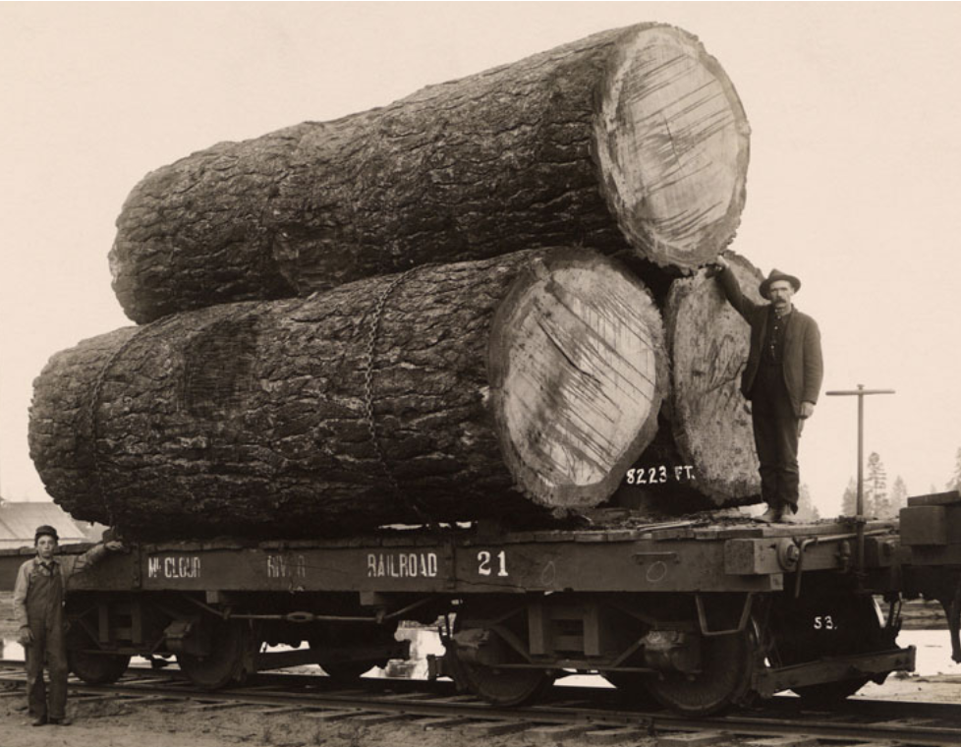
STEP 2 Collecting the logs

Slide 18
# agent based or agentless forwarding
Either use an agent to forward logs
Logstash, Splunk forwarder, ArcSight Connector, etc
Or use the built in capabilities of the operating system
Windows Event Forwarding (WEF), syslog, etc

Slide 19
# windows event forwarding
Any Windows server can be a Windows Event Collector (WEC) server
The WEC server has a subscription file that tells the workstations what to send
Use GPO to tell workstations who their WEF collector is
Workstations must have winrm configured
@jepayneMSFT has some great blogs and videos about WEF for Hunting
https://docs.microsoft.com/en-us/windows/security/threat-protection/use-windows-event-forwarding-to-assist-in-intrusion-detection

Slide 20
# WEF subscription
Recommended events to collect in your WEF subscription
All sysmon events – you’ve already filtered them
Logon events – success (4624), failure (4625), special login (4672)
Services – change (7040), new services (7045)
USB events - Microsoft-Windows-Kernel-PnP (410 and 420)
Kerberos events from the DC – TGT requested (4768), TGT failed (4771)
AD Object changes from the DC – See Microsoft recommendations

Slide 21





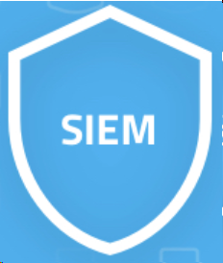
# send it from the WEF to your analytic system
Use Beats, Splunk forwarder, or other agent to push the events from the WEF to the analytic system
Kafka is useful for collecting the data and sending it to multiple SIEMs
Servers
WEF Server
Workstations
Networking Devices

Slide 22

Step 3: Build things with the logs

Slide 23
# alerts – not the point of the talk but still important
Sigma - By Florian Roth @cyb3rops
https://github.com/Neo23x0/sigma
Open source project for generic SIEM rules
Comes with a script to format all of the rules for your SIEM
Many of the rules require Sysmon
ElastAlert – https://github.com/Yelp/elastalert
Framework for custom alerting in Elastic
HELK has scripts that download newest Sigma rules to create Alerts

Slide 24
# Dashboards
Make the data easy to use and understand
Don’t make your security people become data scientists
Focus on making repeatable tasks easy
Don’t just focus on alerts, tell a story

Slide 25
# Host Investigation Dashboard
Answer the Who, What, When, Why, & How for a single host
Enter a Hostname or IP address and select a timeframe
Split the dashboard into easy to understand panels
Each panel should answer a question
Whitelist known noise out of the panels
Nessus scans, SCCM, Regular Scheduled Tasks

Slide 26
# Host Investigation Panels – User events
All active users
Display all Distinct values of the User field in Sysmon
Timechart with count of events by user
Successful and failed local authentication
Security event_id 4624,4625
Successful and failed authentication at the DC
Authentication events from the DCs containing the hostname
Kerberos and NTLM

Slide 27
# Host Investigation Panels – Special logins
Elevated Privileges assigned to a login – event_id 4672
Pay close attention to SeDebugPrivilege
Commands Executed by the SYSTEM user
event_id:1 user_account:SYSTEM
SYSTEM shouldn’t run whoami.exe, or ping.exe, or ipconfig.exe, etc…
Network Connections by SYSTEM privilege processes
event_id:3 user_account:SYSTEM

Slide 28
# Host Investigation Panels– Downloaded files
Sysmon event_id 15 – creation of Alternate Data Streams (ADS)
Files downloaded from the internet are given an ADS for tracking
Each event contains the filename, User and Process that downloaded the file
event_id:15

Slide 29
# Host Investigation Panels– Process execution
Processes executed by cmd, powershell, wscript, or cscript
Good for quickly finding strange activity or administrative actions
event_id:1 AND (process_parent_name:*\\cmd.exe OR process_parent_name:*\\powershell* OR process_parent_name:*\\wscript.exe OR process_parent_name:*\\cscript.exe)
All Distinct Process Command Line, grouped by User
This panel will quickly show you suspicious processes without duplicates

Slide 30
# Host Investigation Panels– Network Connections
Strange Network Connections – exclude Chrome, Outlook, etc.
This panel must be customized for each domain, whitelist known scripts
event_id:3 AND process_path!:*\\chrome.exe AND process_path!:*\\outlook.exe AND etc.
Network Connections sorted by time - event_id:3
This panel will be very noisy, but is good for deep analysis
Additional Panels with IP information from Proxy, Firewall, Bro, etc.

Slide 31
# Host Investigation Panels– Changes to the host
Registry modifications – Sysmon has 3 events for Registry changes
event_id:12 OR event_id:13 OR event_id:14
Any new files created – Sysmon Event has User and Process that created file
event_id:11
New Services installed or changed
event_id:7040 OR event_id:7045
Drivers Loaded – Pay attention to the Signature and Signed values
event_id:6

Slide 32
# Host Investigation Panels – Changes to the host
USB device changes – insertion and removal
event_id:410 OR event_id:420
WMI Subscription changes – Used for ‘file-less’ persistence
event_id:19 OR event_id:20 OR event_id:21

Slide 33
# User Investigation Dashboard
Display all activity by a compromised user account
Attackers will compromise an account to move laterally and spread
Very Similar to the Host Investigation Panel
If you have AD User information you can enrich the dashboard
Get-ADUser

Slide 34
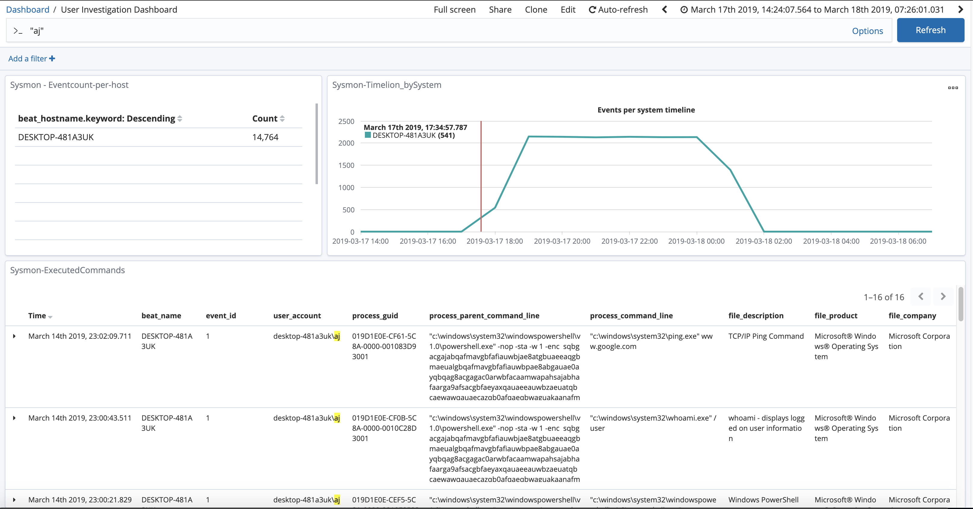
# User Investigation Dashboard

Slide 35
# User Investigation Dashboard
List of all Computers the user executed processes on
Timeline of activity on each system
Using sysmon events instead of authentication events shows you how active the user was on each system
Successful and failed login attempts
(event_id:4624 OR event_id:4625 OR event_id:4648)

Slide 36

# User Investigation Dashboard
All Processes and commands executed, on every computer
All Network Connections, on every computer
All Files Downloaded, on every computer
All Files Created, on every computer
All registry modifications, on every computer
Totally not creepy...

Slide 37
# Process Investigation Dashboard
In Sysmon every process execution has a Unique ProcessGuid
Process Execution events have the ProcessGuid and ParentProcessGuid
Searching for a ProcessGuid will return every event about that process
Network Connections, Files Created, Registry Changes, Child Processes, etc.
Make a dashboard to sort and display all activity by a process
Add multiple Guids with OR statements to get a better view of events

Slide 38
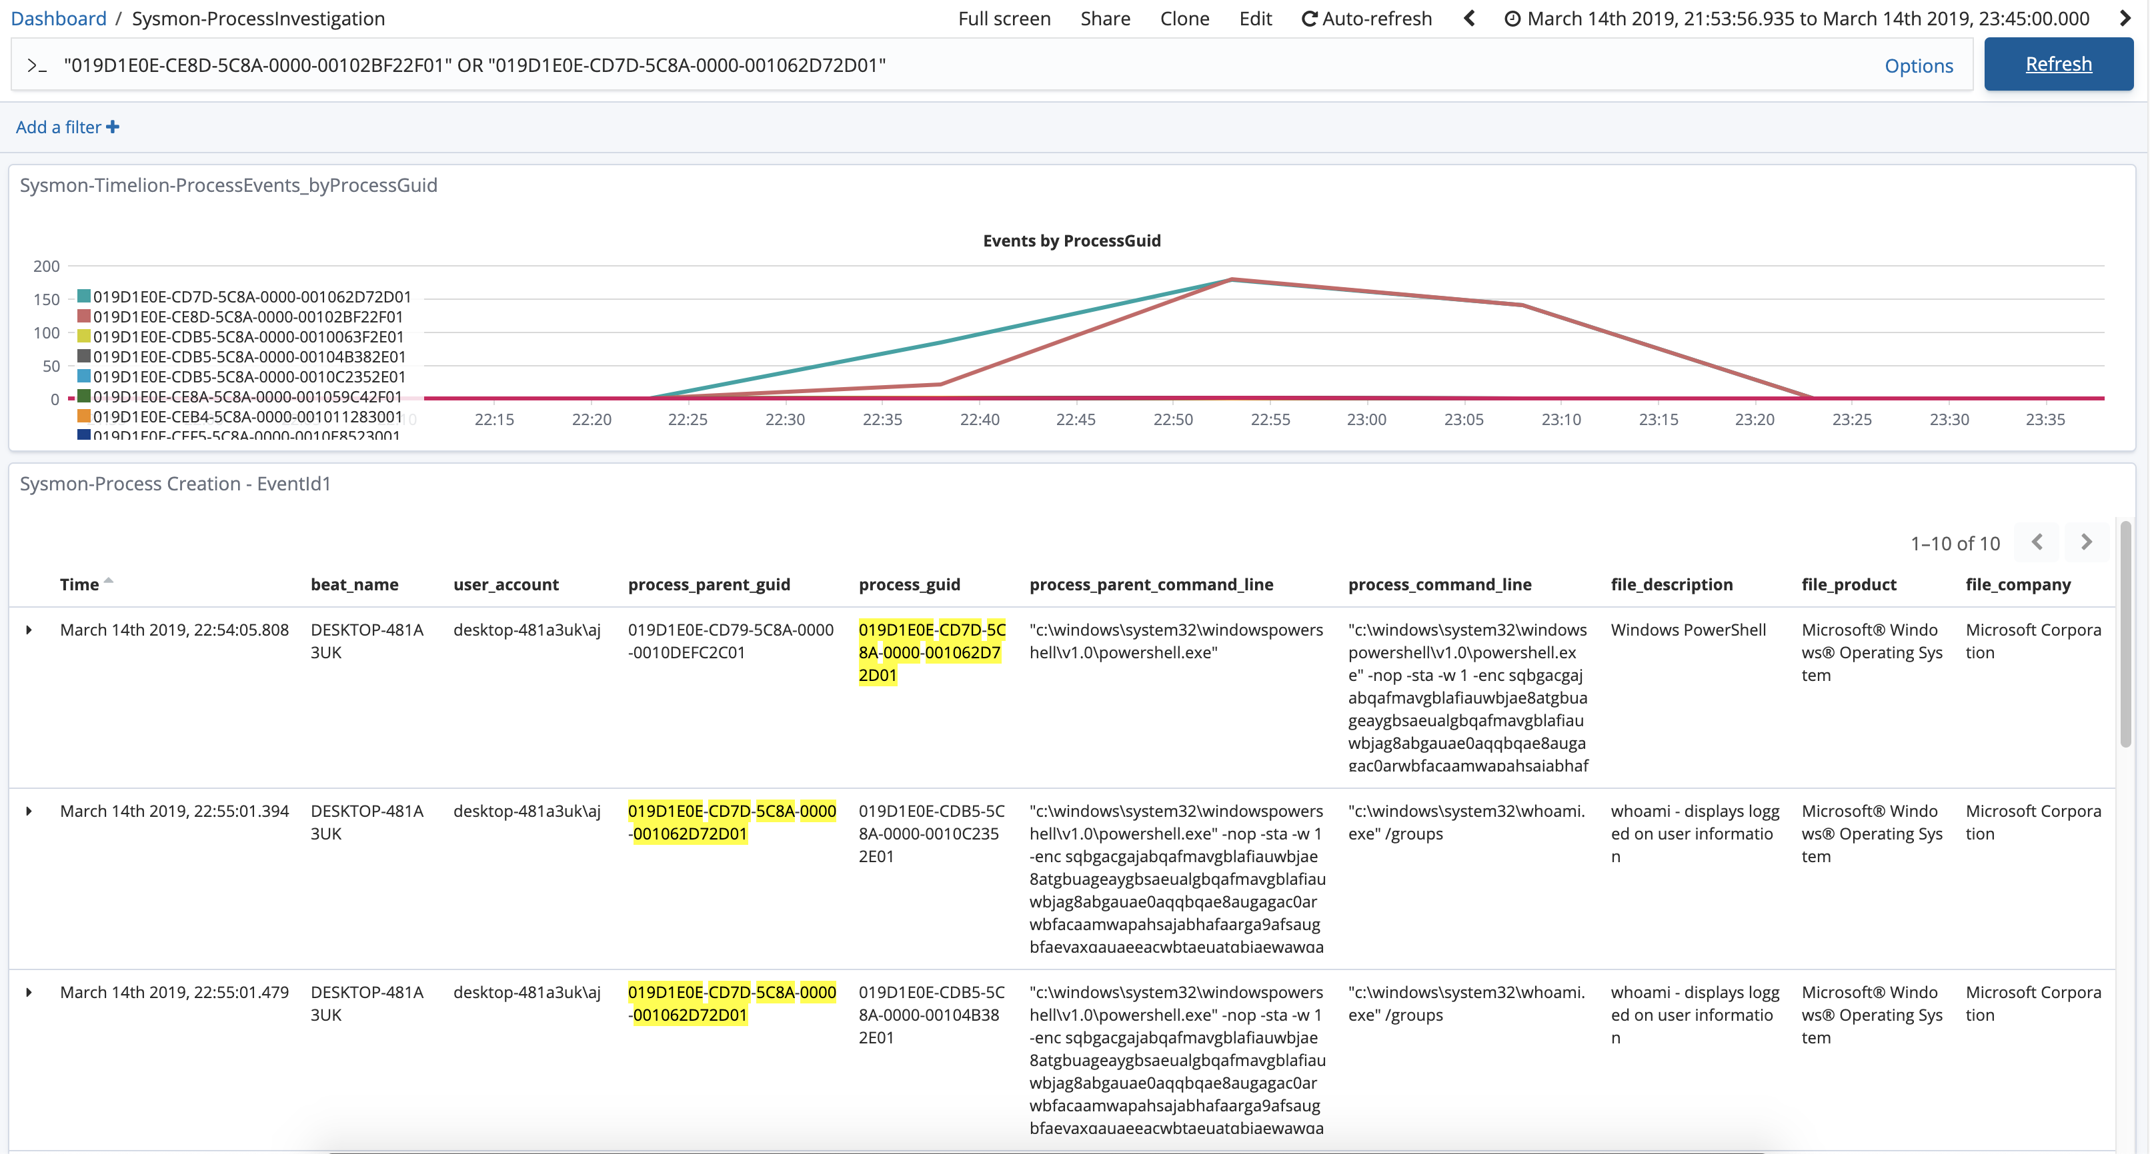

Slide 39
# Conclusion
Any org can build these dashboards and alerts for very little $$$
These Dashboards aren’t just for the security team
DevOps, Active Directory, Help Desk, and other admins love them!
With these Dashboards your Security team can find the problem quickly instead of spending hours or days collecting all of the data

Slide 40
# Questions?
Slides and Kibana Dashboards are on Github
https://github.com/aarju/Kibana_ForensicDashboards
These Dashboards were developed to work with Hunting ELK (HELK)
You may need to adjust the field names in your ELK stack
https://github.com/Cyb3rWard0g/HELK

